Slide 1
CityFinder: a VA system to find the best new location for you!
Ashby, Glenvelis, Sarah, and Susie

Slide 2

Our Purpose
What
Why
CityFinder aims to help people, particularly young adults, find locations that best fit their needs/wants.
It’s a hub that users can go to to find the information they want and that can be hard to find in one place.
Question: What are the best cities for recent graduates to move to?
There are a lot of factors that contribute to finding a city to live in.
We want to streamline the process of comparing cities for users who may be curious or relying on this information to make an informed choice about their next place of residence.
Notes:
a. An introduction to your analysis, including the motivation behind it. [1pt]
Pic citation: https://moving.selfstorage.com/things-to-consider-when-deciding-where-to-move/

Slide 3
Our Data
Sources Include:
Census
Federal Reserve
National Association of Realtors
USDA
FBI
Income
Food Cost
Walkability
Social Demographics
Housing
Crime Rate
Notes:
b. A brief overview of the context for your data. [1pt]
We chose the factors because they seemed like key things to consider especially when moving to a city where costs and demographics can be highly variable but its not an exhaustive list. Because our target audience is people our age, we didn’t include some factors, such as quality of schools, that could be key considerations for other people. A lot of our data comes from census

Slide 4
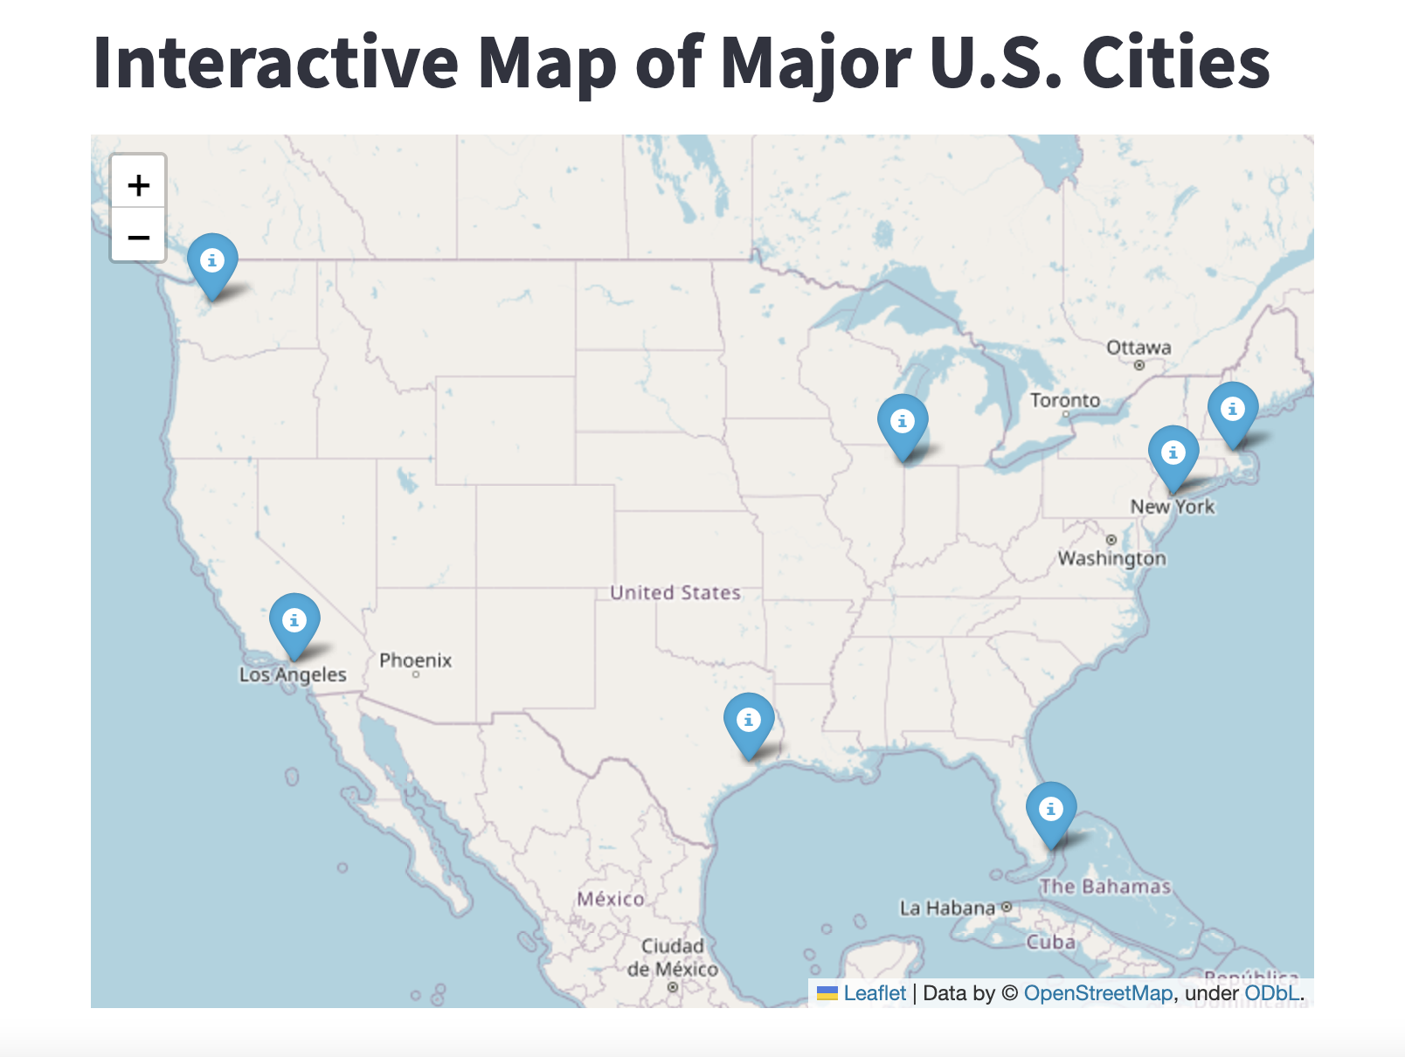
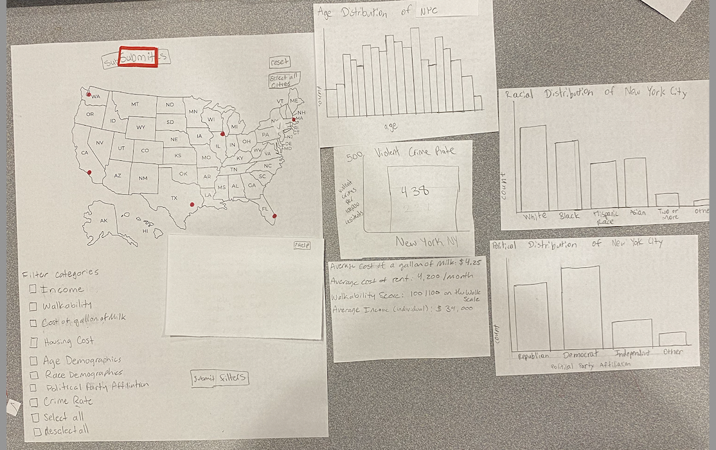
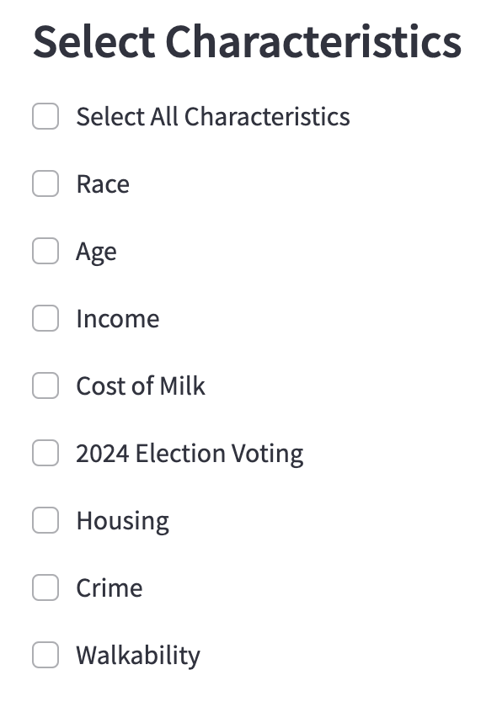
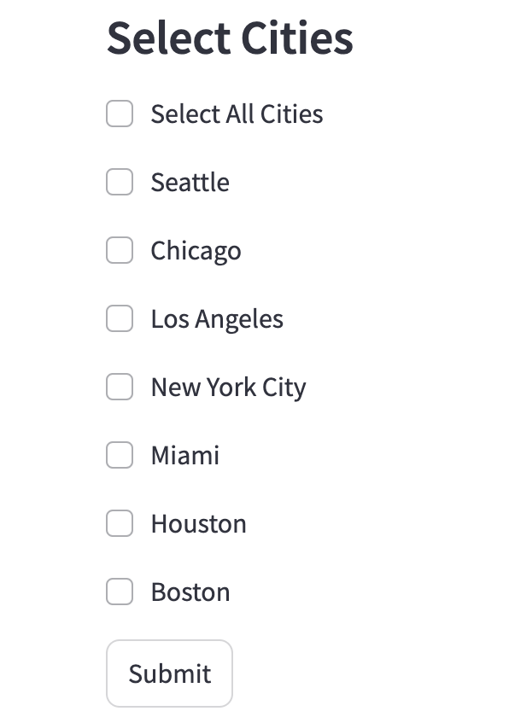
Our Design
Final Design
Initial Design

Slide 5
Our Tasks
#3: Compare cost of living between Chicago and Houston
#2: Display all characteristics of NYC
#1: Identify the age, race, and political distribution of Boston residents
Persona Example: Jared is a 24 year old, recent computer science graduate from UIUC. They’re comparing job offers located in Seattle and Miami and wants to use CityFinder to decide the best city for him. His hobbies include baking and walking his dog. After 4 years in southern Illinois, they want to move to a more liberal area. He also wants to start building his savings so he can retire early.
Notes:
. A demonstration of your visual analytic tool. To demonstrate, show us the completion of the three tasks your tool supports. [2pts per task]

Slide 6
Conclusion
Question: What are the best cities for recent graduates to move to and can our VA system help to answer this question?
Yes! Our tool can help users learn more about the characteristics of a city, in an accessible, streamlined way.
Best for Walkability: NYC
Most Affordable: Houston
Biggest Population of 18-24 year olds: Boston
Most Democratic in last Election: New York City Highest Income: New York City
Most Diverse (least white): New York City
Notes:
A conclusion—answer the analysis question you posed to start

Slide 7
THANKS
QUESTIONS?
Notes:
e. Time for Q&A. In total, your presentation should be ~10 minutes. [1pt]

Slide 8
Sources:
Racial and Age Demographics: https://www.census.gov/quickfacts/
Income: https://www.stlouisfed.org/
Housing: https://www.nar.realtor/sites/default/files/2024-11/metro-home-prices-q3-2024-single-family-2024-11-07.pdf
Milk Prices: https://downloads.usda.library.cornell.edu/usda-esmis/files/0p097320x/kh04gh647/3n205t67t/AMS_3356.PDF&sa=D&source=docs&ust=1733430203335559&usg=AOvVaw2nOfuBpZaOUdQNtP0i-Oy1
Walkability: https://www.epa.gov/smartgrowth/national-walkability-index-user-guide-and-methodology
Crime: https://cde.ucr.cjis.gov/LATEST/webapp/#/pages/explorer/crime/crime-trend
2024 Election Voting: https://github.com/tonmcg/US_County_Level_Election_Results_08-24/blob/master/2024_US_County_Level_Presidential_Results.csv
Streamlit Documentation: https://docs.streamlit.io/

